Slide 1
Software Engineering
UNIT-III
B.Tech (CSE)-IV SEM
Dept of CSE

Slide 2

UNIT-III: Software Architecture: Role of software architecture, Architecture views, components and connector view, documenting architecture design, evaluating architectures.
Design: Design concepts, Function-oriented design, Object oriented design, Detailed design.
SRI VASAVI ENGINEERING COLLEGE
PEDATADEPALLI, TADEPALLIGUDEM-534 101
Department of Computer Science & Engineering
Academic Year:2020-21
Course Title: Software Engineering
Course Code: V18CST06
Semester:IV
Syllabus

Slide 3

UNIT-III
SOFTWARE ARCHITECTURE
& design
SRI VASAVI ENGINEERING COLLEGE
PEDATADEPALLI, TADEPALLIGUDEM-534 101
Department of Computer Science & Engineering

Slide 4
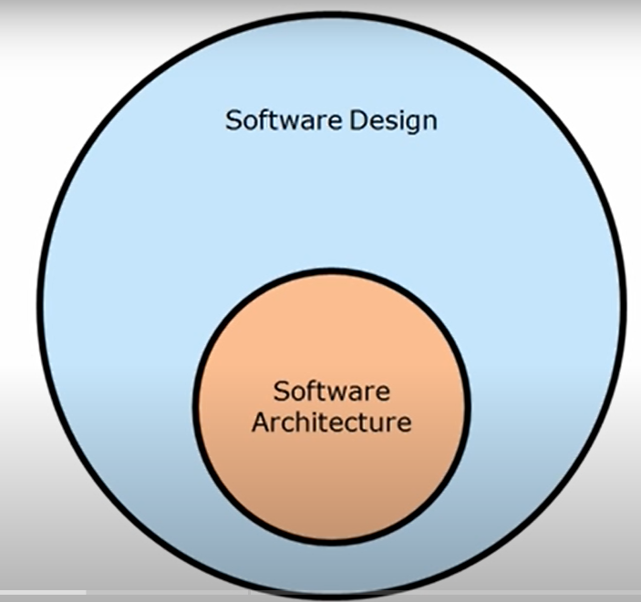
After gathering of business requirements by a business analyst then developer team starts working on the Software Requirement Specification (SRS), sequentially it undergoes various steps like design, Implementation, testing, acceptance, deployment, maintenance etc.
After Requirements gathering the main important step in software Development life cycle is Design.
Architecture is the part of Design Phase.
Dept of CSE

Slide 5
Role of Software Architecture
Software Architecture Def:
Software architecture of a system provides a very high level view of the parts of the system and how they are related to form the whole system. It defines how components of a software system are assembled, their relationship and communication between them. It serves as a blueprint for software application and development basis for developer team.
Dept of CSE

Slide 6
What is the use of software architecture?
Software architecture in software engineering helps to expose the structure of a system while hiding some implementation details. Architecture focuses on relationships and how the elements and components interact with each other.
A software architecture defines structure of a system.
A software architecture defines behavior of a system.
A software architecture defines component relationship.
A software architecture defines communication structure.
A software architecture balances stakeholder’s needs.
A software architecture influences team structure.
A software architecture focuses on significant elements.
A software architecture captures early design decisions.
Architectural design is concerned with understanding how a system should be organized and designing the overall structure of that system.
Dept of CSE

Slide 7
most widely accepted definitions of software architecture:
software architecture of a system is the structure or structures of the system, which comprise software elements, the externally visible properties of those elements, and the relationships among them.
Dept of CSE

Slide 8
Importance of Software Architecture :
An architecture description of a system will therefore describe the different structures of the system.
The next natural question is why should a team building a software system for some customer be interested in creating and documenting the structures of the proposed system.
Some of the important uses that software architecture descriptions play are:
1. Understanding and communication. An architecture description is primarily to communicate the architecture to its various stakeholders, which include the users who will use the system, the clients who ordered the system, the builders who will build the system.
Through this description the stakeholders gain an understanding of some main properties of the system and how the system will fulfill the functional and quality requirements. As the description provides a common language between stakeholders, it also becomes the vehicle for negotiation and agreement among the stakeholders, who may have conflicting goals.
Dept of CSE

Slide 9
2. Reuse. The software engineering world has, for a long time, been working toward a discipline where software can be assembled from parts that are developed by different people and are available for others to use.
If one wants to build a software product in which existing components may be reused, then architecture becomes the key point at which reuse at the highest level is decided.
The architecture has to be chosen in a manner such that the components which have to be reused can fit properly and together with other components that may be developed.
Software architectures are reused by selecting those features required in a new system architecture from the existing system architecture.
Dept of CSE

Slide 10
3.Construction and Evolution.
  Some structures in architecture description will be used to guide system development.
  Partitioning at architecture level can also be used for work allocation to teams as parts are relatively independent.(As architecture partitions the system into different parts, different teams (or individuals) can separately work on different parts for constructing the system.)
  During software evolution, architecture helps to decide what needs to be changed in the existing architecture to incorporate the new changes/features.
  Architecture can helps to decide what is the impact of changes to existing components on others.
Dept of CSE

Slide 11
4.Analysis. It is highly desirable if some important properties about the behavior of the system can be determined before the system is actually built.
This will allow the designers to consider alternatives and select the one that will best suit the needs.
Many engineering disciplines use models to analyze design of a product for its cost, reliability, performance, etc. Architecture opens such possibilities for software also.
It is possible to analyze or predict the properties of the system being built from its architecture. For example, the reliability or the performance of the system can be analyzed. Such an analysis can help determine whether the system will meet the quality and performance requirements, and if not, what needs to be done to meet the requirements.
Dept of CSE

Slide 12
For example, while building a website for shopping, it is possible to analyze the response time or throughput for a proposed architecture, given some assumptions about the request load and hardware. It can then be decided whether the performance is satisfactory or not, and if not, what new capabilities should be added (for example, a different architecture or a faster server for the back end) to improve it to a satisfactory level.
Dept of CSE

Slide 13
You can design software architectures at two levels of abstraction
architecture in the small and architecture in the large:
1. Architecture in the small is concerned with the architecture of individual programs. At this level, we are concerned with the way that an individual program is decomposed into components.
2. Architecture in the large is concerned with the architecture of complex enterprise systems that include other systems, programs, and program components. These enterprise systems are distributed over different computers, which may be owned and managed by different companies.
Dept of CSE

Slide 14
Architecture Views:
According to the def of s/w architecture there is no single architecture to describe a s/w system.
For example in civil construction for a building we will be having floor plan or drawings , Electricity distribution drawings, water distribution drawings and safety and fire fighting drawings.
  These drawings are not independent of each other—they are all about the same building.
  However, each drawing provides a different view of the building, a view that focuses on explaining one aspect of the building and tries to a good job at that, while not discuss much about the other aspects.
  And no one drawing can express all the different aspects—such a drawing will be too complex to be of any use.
Dept of CSE

Slide 15
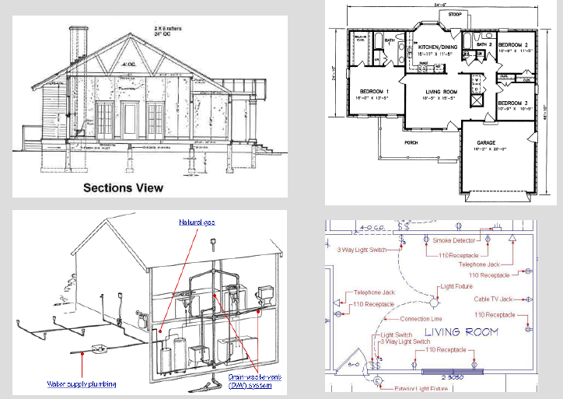

Dept of CSE

Slide 16
Similar is the situation in software architecture.
In software, the different drawings are called views.
VIEW : A view represents the system as set of elements and relationships between them , describe the structure of the system.
  The elements of a view depends on what the view wants to highlight.
  Different views expose different properties and attributes, thereby allowing the stakeholders and analysts to properly evaluate those attributes for the system.
  By focusing only on some aspects of the system, a view reduces the complexity to reader and helps in system understanding and analysis.
Dept of CSE

Slide 17
Most of the proposed views generally belong to one of these three types:
– Module
– Component and connector
– Allocation
1) Module View:
  In a module view, the system is viewed as a collection of code units, each unit represents some part of the system functionality.
  That is, the main elements in this view are modules.
  These views are code-based and do not explicitly represent any runtime structure of the system.
  Examples of modules are packages, a class, a procedure, a method, a collection of functions, and a collection of classes.
Dept of CSE

Slide 18
The relationships between these modules are also code-based and depend on how code of a module interacts with another module.
Examples of relationships in this view are
  “is a part of” (i.e., module B is a part of module A),
  “uses or depends on” (a module A uses services of module B to perform its own functions and correctness of module A depends on correctness of module B),
  and “generalization or specialization” (a module B is a generalization of a module A).
Dept of CSE

Slide 19
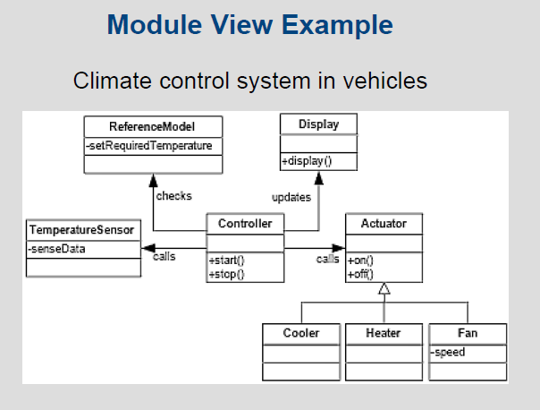
In UML Diagrams packages and class Diagrams represents module view
Dept of CSE

Slide 20
Usage of Module Views
Static functional decomposition
System information architecture
Supports the definition of work assignments, development process and schedules
  Blueprint for coding and testing
  Change-impact analysis
  Requirements traceability analysis
“It is unlikely that the documentation of any software architecture can be complete without at least one module view.”
Dept of CSE

Slide 21
2) Component and Connector (C&C) View:
In a component and connector (C&C) view, the system is viewed as a collection of runtime entities called components.
  I.e. a component is a unit that has identity in executing system, e.g. objects, processes,clients,servers,datastores, .exe, .dll.
While executing, components need to interact with others to support the system services so we need components.
  Connectors provide means of interaction between components, e.g. pipes, shared memory, sockets, RPC, Interfaces and JDBC access etc….
If the components use some middleware to communicate and coordinate, then the middleware is a connector.
Hence, the primary elements of this view are components and connectors.
Dept of CSE

Slide 22
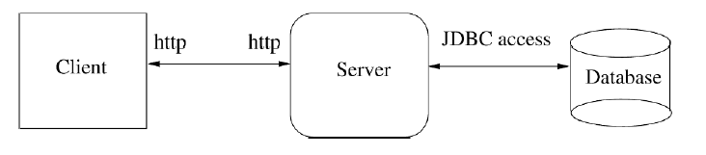
Dept of CSE

Slide 23
C & C Views – Constraints and Usage
Usage :
Major executing components
Major shared data stores
Runtime interaction; e.g., control and data flow, parallelism
Connector mechanisms – e.g., service invocation, asynchronous messaging, event subscription, …
Constraints :
All attachments are only between components and connectors
Attachments must be between compatible ports and roles
Dept of CSE

Slide 24
3) Allocation View:
An allocation view focuses on how the different software units are allocated to resources like the hardware, file systems, and people.
That is, an allocation view specifies the relationship between software elements and elements of the environments in which the software system is executed.
They expose structural properties like which processes run on which processor, and how the system files are organized on a file system, which file resides where etc
Dept of CSE

Slide 25
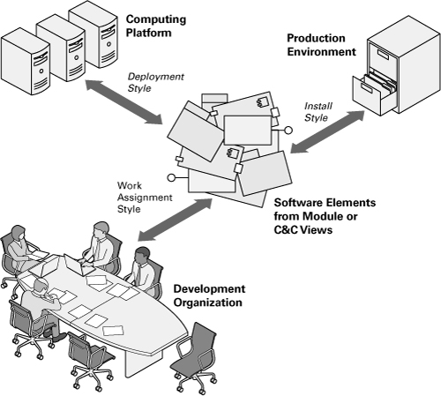
Dept of CSE

Slide 26
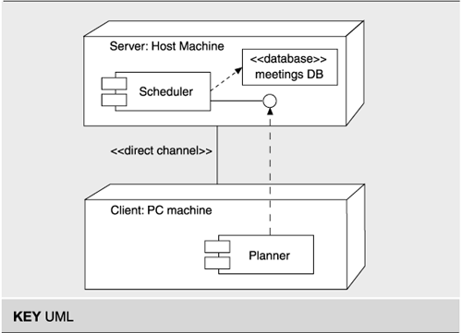
Dept of CSE

Slide 27
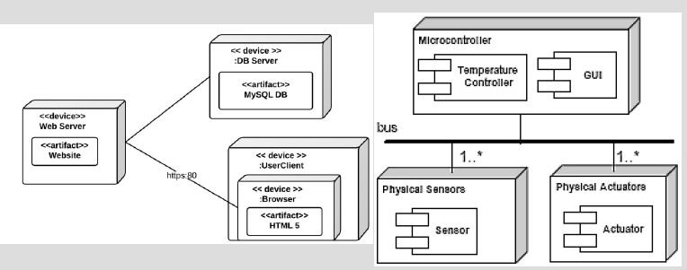
Dept of CSE

Slide 28
Discussion:
An architecture description consists of views of different types, with each view exposing some structure of the system.
  Module views show how the software is structured as a set of implementation units,
  C&C views show how the software is structured as interacting runtime elements, and
  allocation views show how software relates to nonsoftware structures.
These three types of view of the same system form the architecture of the system.
Dept of CSE

Slide 29
Note that the different views are not unrelated. They all represent the same system.
Hence, there are relationships between elements in one view and elements in another view.
These relationships may be simple or may be complex.
For example, the relationship between modules and components may be one to one in that one module implements one component.
On the other hand, it may be quite complex with a module being used by multiple components, and a component using multiple modules.
While creating the different views, the designers have to be aware of this relationship.
Dept of CSE

Slide 30
The next question is what are the standard views that should be expressed for describing the architecture of a system?
To answer this question, the analogy with buildings may again help.
If one is building a simple small house, then perhaps there is no need to have a separate view describing the emergency and the fire system.
Similarly, if there is no air conditioning in the building, there need not be any view for that.
On the other hand, an office building will perhaps require both of these views, in addition to other views describing plumbing, space, wiring, etc.
However, despite the fact that there are multiple drawings showing different views of a building, there is one view that predominates in construction—that of physical structure.
Dept of CSE

Slide 31
This view forms the basis of other views in that other views cannot really be completed unless this view can be done. Other views may or may not be needed for constructing a building, depending on the nature of the project.
The situation with software architecture is also somewhat similar. As we have said, depending on what properties are of interest, different views of the software architecture are needed. However, of these views, the C&C view has become the defacto primary view, one which is almost always prepared when an architecture is designed (some definitions even view architecture only in terms of C&C views). In this chapter, we will focus primarily on the C&C view.
Dept of CSE

Slide 32
Component and Connector View:
The C&C architecture view of a system has two main elements—components and connectors.
Components are usually computational elements or data stores that have some presence during the system execution.
Connectors define the means of interaction between these components.
A C&C view of the system defines the components, and which component is connected to which and through what connector.
A C&C view describes a runtime structure of the system— what components exist when the system is executing and how they interact during the execution.
The C&C structure is essentially a graph, with components as nodes and connectors as edges.
The C&C view is perhaps the most common view of architecture and most box-and-line drawings representing architecture attempt to capture this view.
Dept of CSE

Slide 33
Components:
Components are generally units of computation or data stores in the system.
A component has a name, which is generally chosen to represent the role of the component or the function it performs.
The name also provides a unique identity to the component, which is necessary for referencing details about the component in the supporting documents as a C&C drawing will only show the component names..
it is highly desirable to have a different representation for different component types, so the different types can be identified visually in C&C view.
It is much better to use a different symbol/notation for each different component type for better understandable to the reader .
Dept of CSE

Slide 34
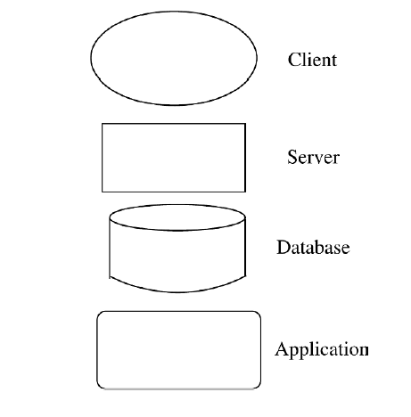
Some of the common symbols used for representing commonly found component types are shown in Figure
Dept of CSE

Slide 35
Connectors:
Interaction between components happen through connectors to provide the services expected of the system.
Interaction between components may be simple.
example : communication between processes in OS like pipes.
Interaction between components may be complex mechanisms as well.
Examples of such mechanisms are remote procedure call, TCP/IP ports, and a protocol like HTTP.
These mechanisms require a fair amount of underlying runtime infrastructure, as well as special programming within the components to use the infrastructure.
Note that connectors need not be binary and a connector may provide an n-way communication between multiple components. For example, a broadcast bus may be used as a connector, which allows a component to broadcast its message to all the other components.
Dept of CSE

Slide 36
A connector has a name and type that should describe the nature of interaction between the components by specifying properties like whether it is a binary or n-way, types of interfaces it supports, etc.
Best to use diff notation for diff types of connectors; all connectors should not be shown by simple lines.
Some of the common symbols used for representing commonly found connector types are shown in below diagram.
Dept of CSE

Slide 37
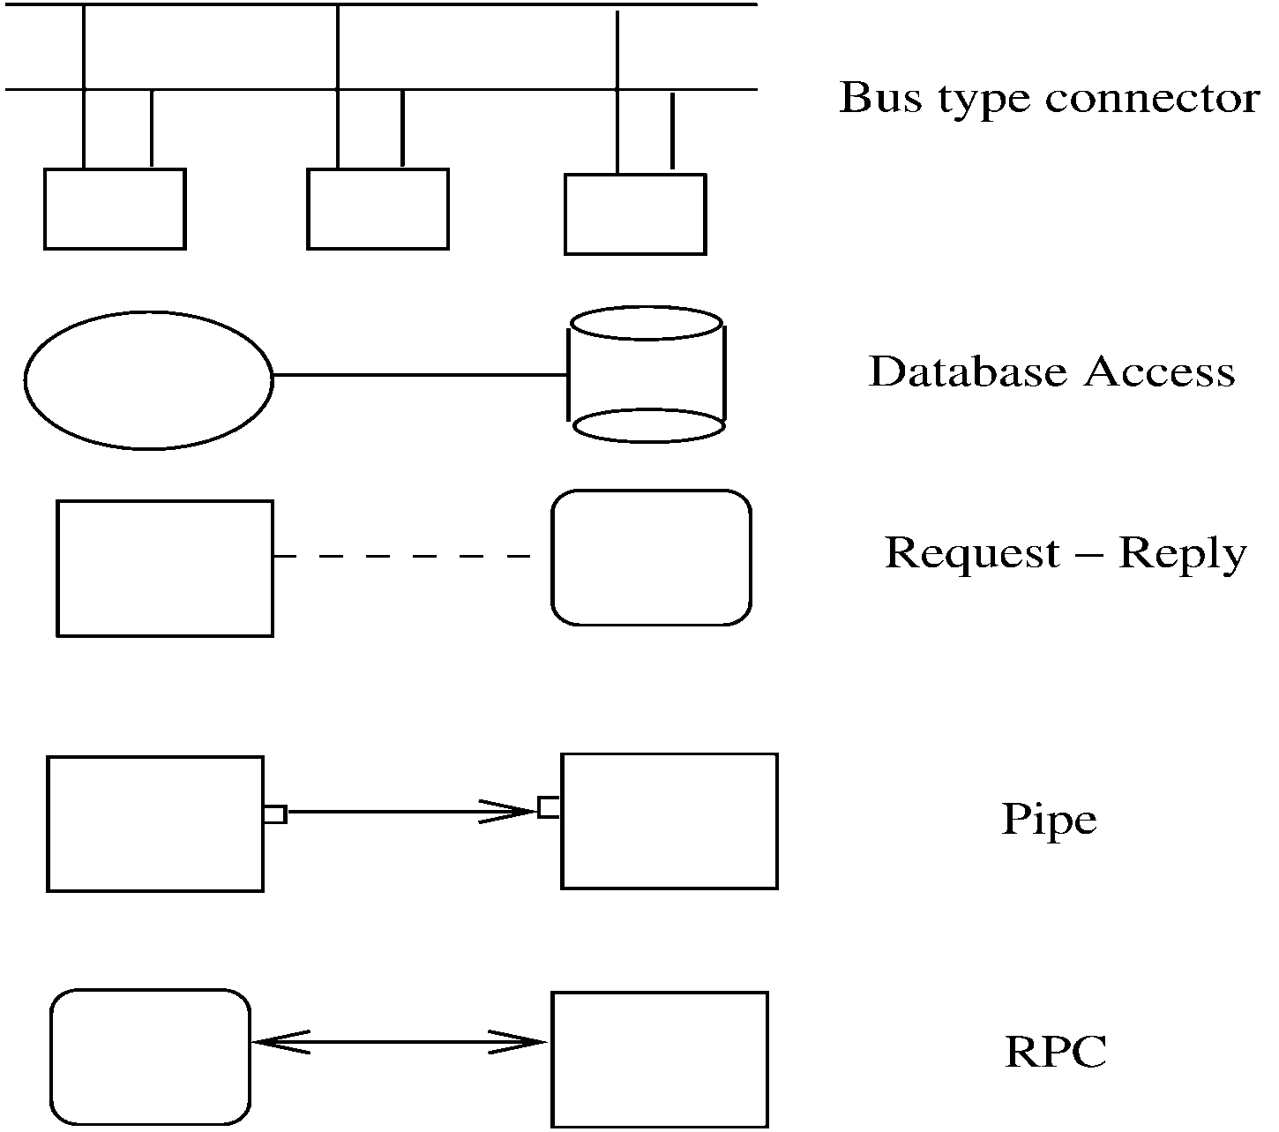
Dept of CSE

Slide 38
An Example:
Suppose we have to design and build a simple system for taking an on-line survey of students on a campus.
  Survey has Multiple choice questions, students need to submit online
  When a student submits, current result of the survey is shown which option is submitted for which question
It is best to built using web; a 3-tier architecture is proposed
  Has a client, server, and a database components (each of a diff type)
    client which will display the form that the student can complete and submit, and will also display the results.
    server, which processes the data submitted by the student, and saves it on the database, which is the third component.
    Connector between them are also of diff types
Dept of CSE

Slide 39
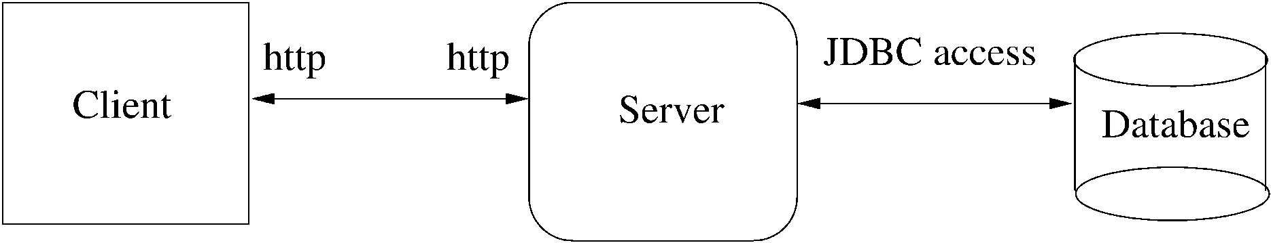
The C&C view is shown in Figure.
Note that the client, server, and database are all different types of components, and hence are shown using different symbols.
Note also that the connectors between the components are also of different types.
The diagram makes the different types clear, making the diagram stand alone and easy to comprehend.
Dept of CSE

Slide 40
Extension 1:
This arch has no security – anyone can take the survey
We want that only registered students can take the survey (at most once)
  To identify students and check for one-only submission, need a authentication server
  Need to use cookies, and server has to be built accordingly (the connector between server and auth server is http with cookies)
Dept of CSE

Slide 41
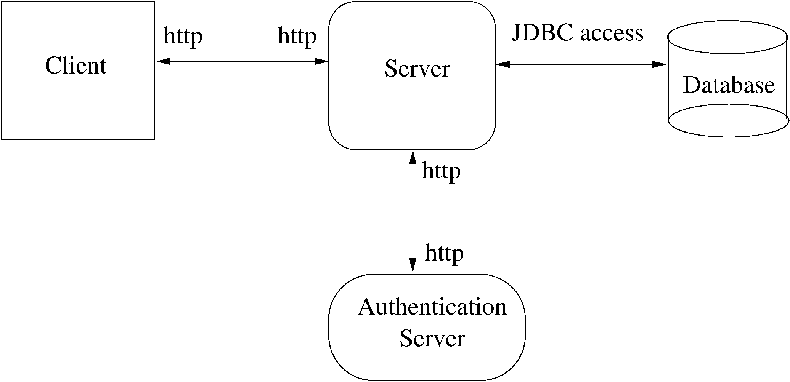
Dept of CSE

Slide 42
Extension 2:
It was found that DB is frequently down
For improving reliability, want that if DB is down,
  It was also felt that when the student is given the result of the survey when he submits the form, a somewhat outdated result is acceptable, as the results are really statistical data and a little inaccuracy will not matter.
  We assume that the survey result can be outdated by about 5 data points (even if it does not data given can be outdated by at most 5 survey data points include data of 5 surveys, it is OK).
  What the Dean wanted was to make the system more reliable, and provide some facility for completing the survey even when the database is down.
For this, will add a cache component, which will store data as well as results
Dept of CSE

Slide 43
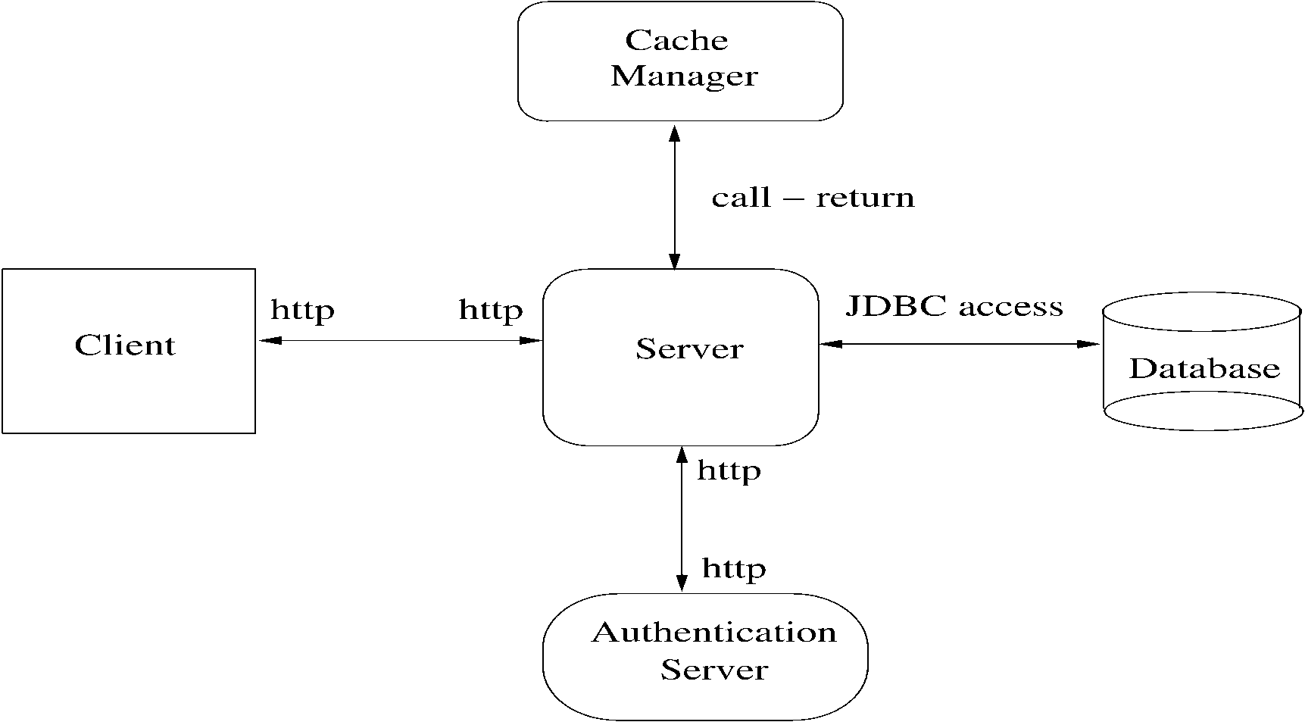
The results of the survey, however, are also stored in the cache by the server. If the database is down or unavailable, the survey data is stored locally in a cache component, and the result saved in the cache component is used to provide the result to the student. (This can be done for up to 5 requests, after which the survey cannot be completed.) So, now we have another component in the server called the cache manager.
Dept of CSE

Slide 44
One change increased security, 2nd increased performance and reliability
I.e. Arch level choices have a big impact on system properties
That is why, choosing a suitable arch can help build a good system
Dept of CSE

Slide 45
Architectural Styles for C&C View:
Diff systems have diff C&C structure
Some structures are general and are useful for a class of problems – architectural styles
An arch style defines a family of archs that satisfy the constraint of that style
Styles can provide ideas for creating arch for a sys; they can be combined also
We discuss a few common styles
Pipe and filter:
Well suited for systems that mainly do data transformations
A system using this style uses a network of transforms to achieve the desired result
Has one component type – filter
Has one connector type – pipe
Dept of CSE

Slide 46
A filter does some transformation and passes data to other filters through pipes
A filter is independent; need not know the id of filters sending/receiving data
Filters can be asynchronous and are producers or consumers of data
A pipe is unidirectional channel which moves streams of data from one filter to another
A pipe is a 2-way connector
Pipes have to perform buffering, and synchronization between filters
Pipes should work without knowing the identify of producers/consumers
A pipe must connect the output port of one filter to input port of another
Filters may have independent thread of control
Dept of CSE

Slide 47
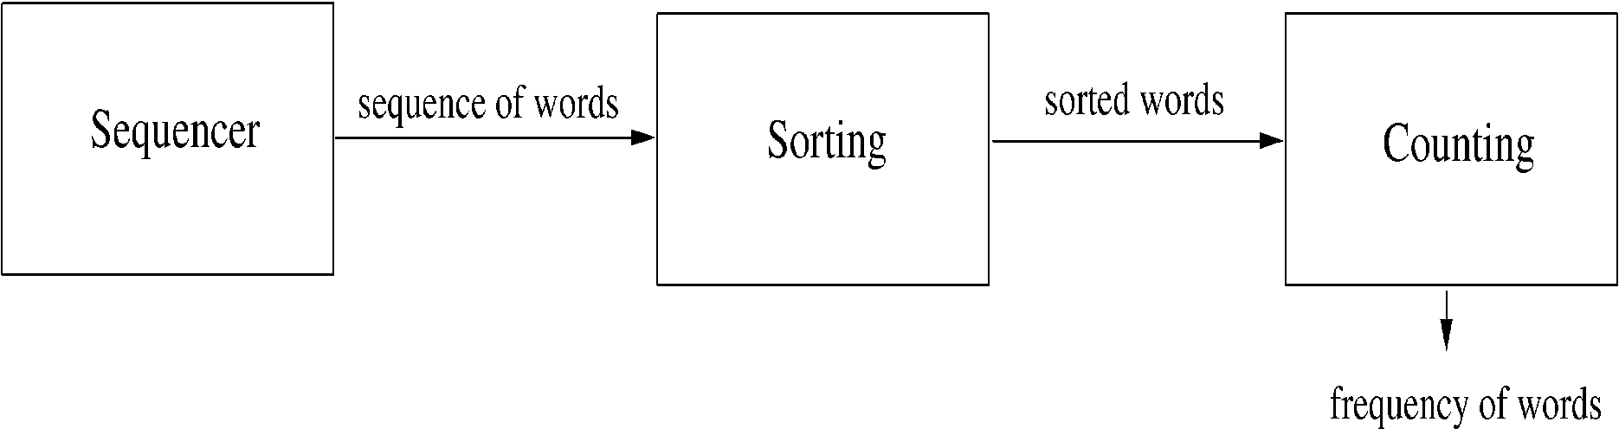
Example:
A system needed to count the frequency of different words in a file
One approach: first split the file into a sequence of words, sort them, then count the #of occurrences
The arch of this system can naturally use the pipe and filter style
Dept of CSE

Slide 48
Shared-data style:
Two component types – data repository and data accessor
Data repository – provides reliable permanent storage
Data accessors – access data in repositories, perform computations, and may put the results back also
Communication between data accessors is only through the repository
Two variations possible
  Black board style: if data is posted in a repository, all accessors are informed; i.e. shared data source is an active agent
  Repository style: passive repository which provides permanent storage and related controls for data accessing.
Eg. database oriented systems; web systems; programming environments,..
Dept of CSE

Slide 49
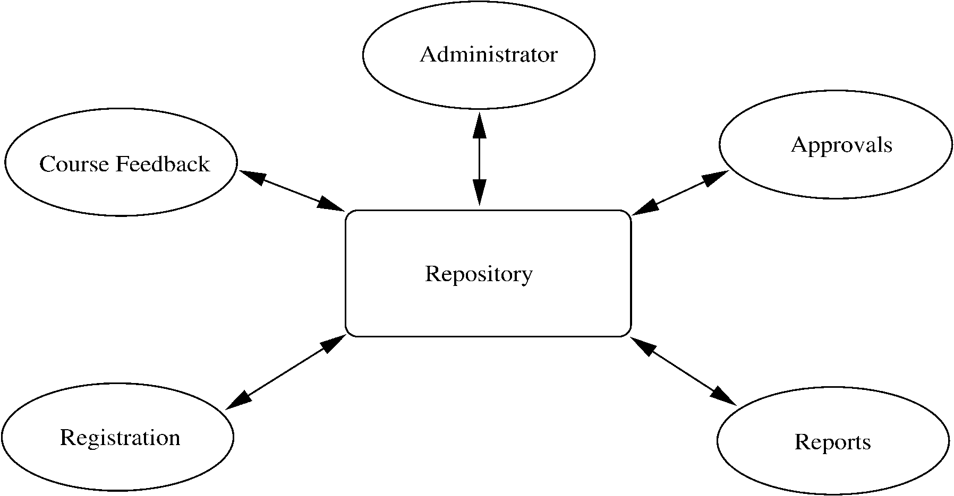
Example:
A student registration system of a university
Repository contains all the data about students, courses, schedules,…
Accessors like admin, approvals, registration, reports which perform operations on the data
Dept of CSE

Slide 50
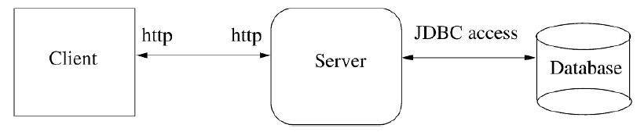
Client-server style:
A general form of this style is the n-tier structure
A 3-tier structure is commonly used by many application and web systems
  Client-tier contains the clients
  Middle-tier contains the business rules
  Database tier has the information
Dept of CSE

Slide 51
Documenting Architecture Design:
So far we have focused on representing views through diagrams.
While designing, diagrams are indeed a good way to explore options and encourage discussion and brainstorming between the architects.
But when the designing is over, the architecture has to be properly communicated to all stakeholders for negotiation and agreement.
Without a properly documented description of the architecture, it is not possible to have a clear common understanding.
Hence, properly documenting an architecture is as important as creating one.
In this section, we discuss what an architecture document should contain.
Dept of CSE

Slide 52
A document describing the architecture should contain the following:
– System and architecture context
– Description of architecture views
– Across views documentation
System and architecture context:
We know that an architecture for a system is driven by the system objectives and the needs of the stakeholders.
Hence, the first aspect that an architecture document should contain is identification of stakeholders and their concerns.
This portion should give an overview of the system, the different stakeholders, and the system properties for which the architecture will be evaluated.
This portion contain a context diagram.
Dept of CSE

Slide 53
A context diagram outlines how external entities interact with an internal software system.
A context diagram that establishes the scope of the system, its boundaries, the key actors that interact with the system, and sources and sinks of data can also be very useful.
A context diagram is frequently represented by showing the system in the center, and showing its connections with people and systems, including sources and sinks of data.
Dept of CSE

Slide 54
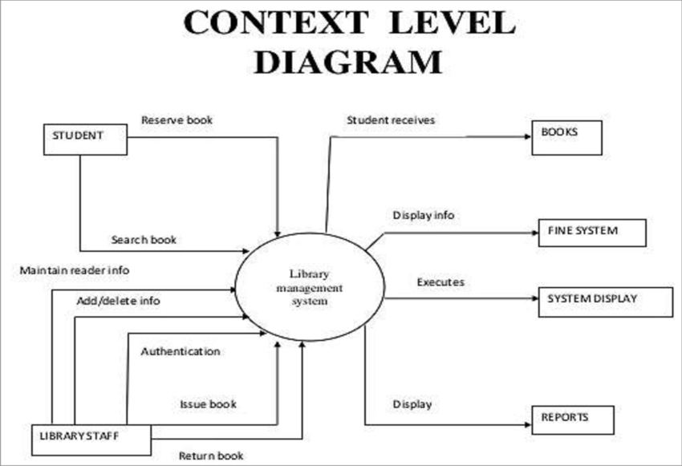
Dept of CSE

Slide 55
Description of architecture views:
With the context defined, the document can proceed with describing the different structures or views.
As stated before, multiple views of different types may be needed, and which views are chosen depends on the needs of the project and its stakeholders.
The description of views in the architecture documentation will almost always contain a pictorial representation of the view, which is often the primary presentation of the view.
As discussed earlier, in any view diagram it is desirable to have different symbols for different element types ,such that the type of the different components is clear to a reader.
Pictorial representation of the view is not sufficient for providing the complete details of the view.
Dept of CSE

Slide 56
Hence, supporting documentation is needed for the view diagrams.
This supporting documentation should have some or all of the following:
– Element Catalog.
  Provides more information about the elements shown in the primary representation.
  Besides describing the purpose of the element, it should also describe the elements’ interfaces (remember that all elements have interfaces through which they interact with other elements). All the different interfaces provided by the elements should be specified.
Dept of CSE

Slide 57
– Architecture Rationale.
  Though a view specifies the elements and the relationship between them, it does not provide any insight into why the architect chose the particular structure.
  Architecture rationale gives the reasons for selecting the different elements and composing them in the way it was done.
– Behavior.
  A view gives the structural information. It does not represent the actual behavior or execution.
  Sometimes, it is necessary to get some idea of the actual behavior of the system in some scenarios.
  Such a description is useful for arguing about properties like deadlock.
  Behavior description can be provided to help aid understanding of the system execution. Often diagrams like collaboration diagrams or sequence diagrams are used.
Dept of CSE

Slide 58
– Other Information.
  This may include a description of all those decisions that have not been taken during architecture creation but have been deliberately left for the future, such as, the choice of a server or protocol.
  If this is done, then it must be specified as fixing these will have impact on the architecture.
Dept of CSE

Slide 59
Across views documentation:
The architecture document, therefore, besides describing the views, should also describe the relationship between the different views. This is the primary purpose of the across view documentation.
Essentially, this documentation describes the relationship between elements of the different views (for example, how modules in a module view relate to components in a component view )
This part of the document can also describe the explanation of the overall architecture, why the selected views were chosen.
Dept of CSE

Slide 60
The general structure discussed here can provide a guide for organizing the architecture document.
However, the main purpose of the document is to clearly communicate the architecture to the stakeholders such that the desired analysis can be done.
And if some of these sections are redundant for that purpose, they may not be included.
Similarly, if more information needs to be provided, then it should be done.
Finally, a word on the language chosen for describing different parts of the architecture.
Here the choice varies from the formal architecture description languages (ADLs) to informal notation.
Many people now use UML to represent the architecture.
Dept of CSE

Slide 61
UNIT -III
Part-2
Design
Dept of CSE

Slide 62
Introduction:
The design activity begins when the requirements document for the software to be developed is available and the architecture has been designed.
During design we further refine the architecture. Generally, design focuses on what we have called the module view in architecture.
That is, during design we determine what modules the system should have and which have to be developed.
The design of a system is essentially a plan for a solution for the system.
Design has two levels – high level (modules are defined and their interconnection is defined), and detailed design (logic of the module is specified).
A design methodology is a systematic approach to creating a design by applying of a set of techniques and guidelines.
Dept of CSE

Slide 63
Design is a creative activity
Goal: to create a plan to satisfy requirements
Perhaps the most critical activity during system development
Design determines the major characteristics of a system
Has great impact on testing and maintenance
Design document forms reference for later phases
Design methodology – systematic approach for creating a design
Dept of CSE

Slide 64
Design Concepts:
The design of a system is correct if a system built precisely according to the requirements of that system.
Clearly, the goal during the design phase is to produce correct designs.
However, correctness is not the only criterion during the design phase, as there can be many correct designs.
The goal of the design process is not simply to produce a correct design for the system.
Instead, the goal is to find the best possible design within the limitations imposed by the requirements and the physical and social environment in which the system will operate.
To evaluate a design, we have to specify some evaluation criteria and that evaluation criteria is modularity of a system,
Dept of CSE

Slide 65
Modularity
A system is said to be modular if it consists of discrete modules so that each module can be implemented separately, and a change to one module has minimal impact on other modules.
Modularity helps in system debugging—isolating the system problem to a module is easier if the system is modular; in system repair—changing a part of the system is easy as it affects few other parts; and in system building—a modular system can be easily built by “putting its modules together.”
Modularity enhances design clarity, eases implementation , Reduces cost of testing, debugging and maintenance.
A software system cannot be made modular by simply chopping it into a set of modules.
Need some criteria for decomposition – coupling and cohesion are such criteria
Dept of CSE

Slide 66
Coupling refers to the degree of interdependence between software modules. High coupling(strong coupling) means that modules are closely connected(dependent) and changes in one module may affect other modules. Low coupling(loose coupling) means that modules are independent and changes in one module have little impact on other modules.
Cohesion refers to the degree to which elements within a module work together to fulfill a single, well-defined purpose. High cohesion means that elements are closely related and focused on a single purpose, while low cohesion means that elements are loosely related(not related ) and serve multiple purposes.
Low coupling and High cohesion make a system easier to maintain and improve.
High coupling and Low cohesion can make a system difficult to change and test.
Dept of CSE

Slide 67
More on Coupling : Coupling is the strength of interconnection between modules or measure of the degree of interdependency between modules.
Coupling increases as the interconnection between modules increases.
Inter connection between the modules is measured by
  Number of function calls
  Number of parameters passed
  Return values
  Sharing of data files or data items
The strength of interconnection between modules is measured by
  Complexity of interfaces
  Type of connection
  Type of communication
Dept of CSE

Slide 68
Types of Coupling:
There are different types of coupling between modules such as
Message Coupling Lowest(best)
Data Coupling
Stamp Coupling
Control Coupling
External Coupling
Common Coupling
Content Coupling Highest(worst)
Dept of CSE

Slide 69
1. Message Coupling
Modules exhibit message coupling when one module calls a method on another and does not send any parameters. The only coupling is on the name of the method, but nothing else. It is the lowest type of coupling.
2. Data Coupling
Data Coupling exists between modules when two modules communicate each other by passing data/parameters in the method call/function call.
3. Stamp Coupling
Stamp coupling occurs between modules when they communicate using composite data items such as structure, objects, etc. When the module passes non-global data structure or entire structure to another module, they are said to be stamp coupled. For example, passing structure variable in C or object in C++ language to a module.
Dept of CSE

Slide 70
4. Control Coupling
One module passes the control data to order the other module to execute.
5. External Coupling
External Coupling arises when two modules share an externally imposed data format, communication protocols, or device interface. Ex All the modules use the same I/O Device, same file ….
6. Common Coupling
Common coupling is said to occur when two modules have access to the same global data items. If there is a change in the shared resource ,it influences all the modules using it.
7. Content Coupling
Content coupling is said to occur when one module uses the code of another module, one module can modify the data(local data) of another module, or control flow is passed from one module to the other module. This is the worst form of coupling and should be avoided.
Dept of CSE

Slide 71
In Object Oriented systems, three different types of coupling exist between modules
1. Interaction coupling
2. Inheritance coupling
3. Component coupling
1. Interaction coupling occurs due to methods of a class invoking methods of other classes. In many ways, this situation is similar to a function calling another function and hence this coupling is similar to coupling between functional modules discussed above.
2. Inheritance coupling is due to the inheritance relationship between classes. Two classes are considered inheritance coupled if one class is a direct or indirect subclass of the other.
Dept of CSE

Slide 72
3. Component coupling refers to the interaction between two classes where a class has variables of the other class. Three clear situations exist as to how this can happen.
-A class C can be component coupled with another
class C1, if C has an instance variable of type C1,
- or C has a method whose parameter is of type C1,
- or if C has a method which has a local variable of
type C1.
Dept of CSE

Slide 73
More on Cohesion : Cohesion is a measure of the degree to which the elements of the module are functionally related. It is the degree to which all elements directed towards performing a single task are contained in the Module.
High cohesion means that elements are closely related and focused on a single purpose, while low cohesion means that elements are loosely related and serve multiple purposes.
Dept of CSE

Slide 74
Types of Cohesion:
There are different types of cohesion such as:
Functional Cohesion Highest (Best)
Sequential Cohesion
Communicational Cohesion
Procedural Cohesion
Temporal Cohesion
Logical Cohesion
Coincidental Cohesion Lowest (Worst)
Dept of CSE

Slide 75
Functional Cohesion: Functional Cohesion is highest cohesion in all the levels. In this all the elements of a module, cooperate to achieve a single function. Ex: the printf() function prints the results.
Sequential Cohesion: Sequential Cohesion exists when the output of one element of a module becomes input for some other element. Ex: withdraw money and update balance both are bound together to withdraw money from an account.
Communicational Cohesion : In Communicational Cohesion all the elements of a module operate on the same input data or contribute towards the same output data. Ex: update record in the database and send it to the printer.
Procedural Cohesion: Elements of procedural cohesion ensure the order of execution. Actions are still weakly connected and unlikely to be reusable. Ex- calculate student GPA, print student record, calculate cumulative GPA, print cumulative GPA.
Dept of CSE

Slide 76
5. Temporal Cohesion: some times , a module performs several functions in a sequence but their execution is related to a certain time. All the functions are activated at a single time , such as startup or shutdown. Ex: a database trigger is activated on executing a certain procedure.
6. Logical Cohesion: Logical Cohesion exists when logically related elements of a module are placed together. All the code for these functions are in the same component. Operations are related, but the functions are significantly different. Ex- A component reads inputs from tape, disk, and network.
7. Coincidental Cohesion: Coincidental Cohesion is the lowest level of cohesion. It occurs when the elements within a given module have no meaningful relationship to each other. Ex- print next line and reverse the characters of a string in a single component.
Dept of CSE

Slide 77
Cohesion in object-oriented systems has three aspects [30]:
– Method cohesion
– Class cohesion
– Inheritance cohesion
Method cohesion: It focuses on why the different code elements of a method are together within the method. The highest form of cohesion is if each method implements a clearly defined function, and all statements in the method contribute to implementing this function.
Class cohesion focuses on why different attributes and methods are together in this class. The goal is to have a class that implements a single concept. In general, whenever there are multiple concepts encapsulated within a class, the cohesion of the class is not as high.
Inheritance cohesion focuses on the reason why classes are together in a hierarchy. The two main reasons for inheritance are to model generalization-specialization relationship, and for code reuse. Cohesion is considered high if the hierarchy supports generalization-specialization of some concept.
Dept of CSE

Slide 78
Differentiate between Coupling and Cohesion
Coupling | Cohesion
Coupling is also called Inter-Module Binding. | Cohesion is also called Intra-Module Binding.
Coupling shows the relationships between modules. | Cohesion shows the relationship within the module.
Coupling shows the relative independence between the modules. | Cohesion shows the module's relative functional strength.
While creating, you should aim for low coupling, i.e., dependency among modules should be less. | While creating you should aim for high cohesion, i.e., a cohesive component/ module focuses on a single function (i.e., single-mindedness) with little interaction with other modules of the system.
In coupling, modules are linked to the other modules. | In cohesion, the module focuses on a single thing.
Dept of CSE

Slide 79
Data Flow Diagram (DFD):
A Data Flow Diagram (DFD) is a traditional visual representation of the information flows within a system. A neat and clear DFD can depict the right amount of the system requirement graphically. It can be manual, automated, or a combination of both.
It shows how data enters and leaves the system, what changes the information, and where data is stored.
The objective of a DFD is to show the scope and boundaries of a system as a whole. It may be used as a communication tool between a system analyst and any person who plays a part in the order that acts as a starting point for redesigning a system. The DFD is also called as a data flow graph or bubble chart.
A data flow diagram (DFD) maps out the flow of information for any process or system. It uses defined symbols like rectangles, circles and arrows, plus short text labels, to show data inputs, outputs, storage points and the routes between each destination.
Dept of CSE

Slide 80
The following observations about DFDs are essential:
All names should be unique. This makes it easier to refer to elements in the DFD.
Remember that DFD is not a flow chart. Arrows is a flow chart that represents the order of events; arrows in DFD represents flowing data. A DFD does not involve any order of events.
Suppress logical decisions. If we ever have the urge to draw a diamond-shaped box in a DFD, suppress that urge! A diamond-shaped box is used in flow charts to represents decision points with multiple exists paths of which the only one is taken. This implies an ordering of events, which makes no sense in a DFD.
Dept of CSE

Slide 81
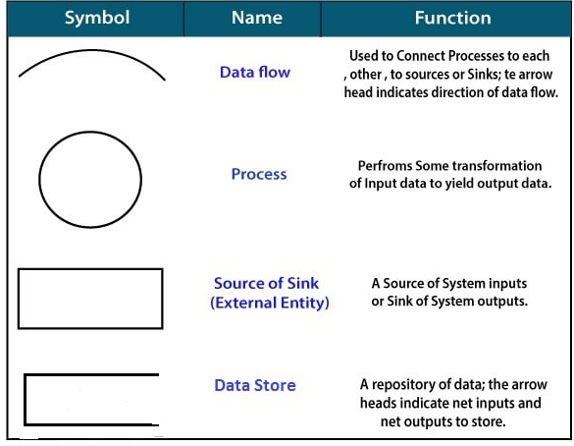
Standard symbols for DFDs are derived from the electric circuit diagram analysis and are shown in fig:
Dept of CSE

Slide 82
Circle: A circle (bubble) shows a process that transforms data inputs into data outputs.
Data Flow: A curved line shows the flow of data into or out of a process or data store.
Data Store: A set of parallel lines shows a place for the collection of data items. A data store indicates that the data is stored which can be used at a later stage or by the other processes in a different order. The data store can have an element or group of elements.
Source or Sink: Source or Sink is an external entity and acts as a source of system inputs or sink of system outputs.
Dept of CSE

Slide 83
Levels in Data Flow Diagrams (DFD)
The DFD may be used to perform a system or software at any level of abstraction. Infact, DFDs may be partitioned into levels that represent increasing information flow and functional detail. Levels in DFD are numbered 0, 1, 2 or beyond. Here, we will see primarily three levels in the data flow diagram, which are: 0-level DFD, 1-level DFD, and 2-level DFD.
0-levelDFD:
It is also known as a context diagram. It’s designed to be an abstraction view, showing the system as a single process with its relationship to external entities. It represents the entire system as a single bubble with input and output data indicated by incoming/outgoing arrows.

Slide 84
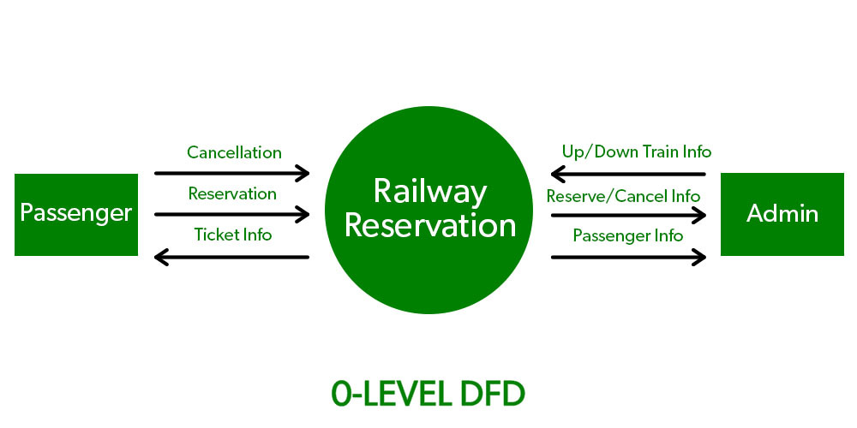
Dept of CSE

Slide 85
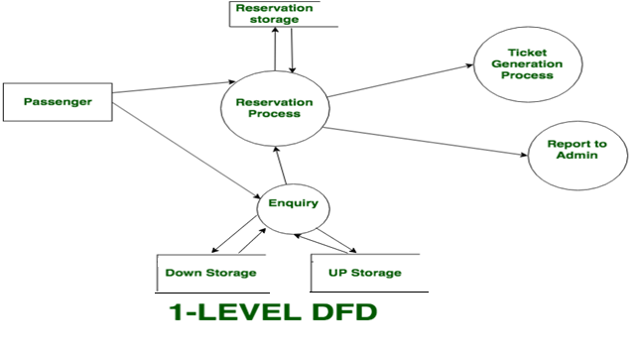
1-levelDFD
In 1-level DFD, the context diagram is decomposed into multiple bubbles/processes. In this level, we highlight the main functions of the system and breakdown the high-level process of 0-level DFD into sub processes.

Slide 86
2-level DFD:
2-level DFD goes one step deeper into parts of 1-level DFD. It can be used to plan or record the specific/necessary detail about the system’s functioning.
Dept of CSE

Slide 87
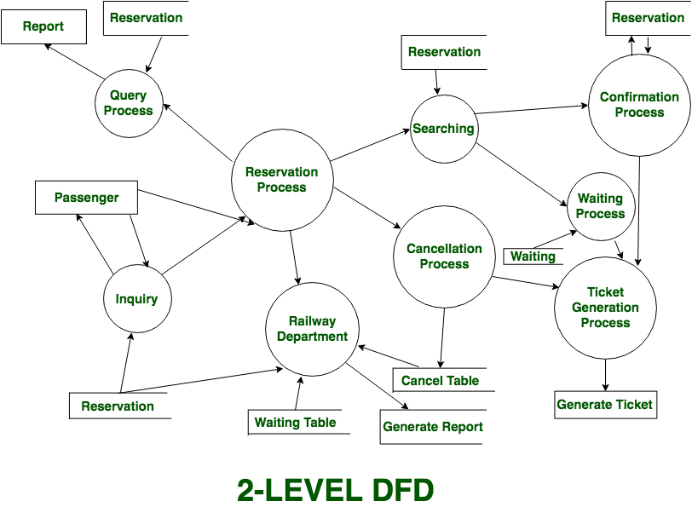
Dept of CSE

Slide 88
Function-Oriented Design:
The aim of design methodologies is not to reduce the process of design to a sequence of mechanical steps but to provide guidelines to aid the designer during the design process.
Function Oriented design is a method to software design where the model is decomposed into a set of interacting units or modules where each unit or module has a clearly defined function. Thus, the system is designed from a functional viewpoint.
We discuss the structured design methodology for developing function-oriented system designs. The methodology employs the structure chart notation for creating the design.
Now we are discussing structured charts
Dept of CSE

Slide 89
Structure Charts
The structure of a program is made up of the modules of that program together with the interconnections between modules.
Every computer program has a structure, and given a program its structure can be determined.
The structure chart of a program is a graphic representation of its structure.
A Structure Chart in software engineering is a chart which shows the breakdown of a system to its lowest manageable parts. They are used in structured programming to arrange program modules into a tree. Each module is represented by a box, which contains the module's name. The tree structure visualizes the relationships between modules, showing data transfer between modules using arrows.
Dept of CSE

Slide 90
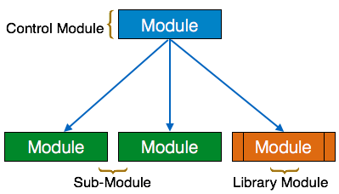
Symbols used in construction of structured chart:
Module: In a structure chart a module is represented by a box with the module name written in the box. It represents the process or task of the system. It is of three types.
  Control Module
  A control module branches to more than one sub module.
  Sub Module
  Sub Module is a module which is the part (Child) of another module.
  Library Module
  Library Module are reusable and invokable from any module.
Dept of CSE

Slide 91
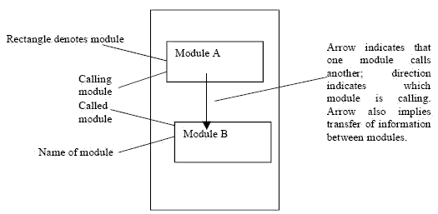
An arrow from module A to module B represents that module A invokes module B. B is called the subordinate of A, and A is called the superordinate of B.
Dept of CSE

Slide 92
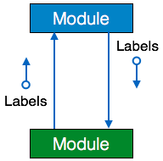
2. Data Flow
It represents the flow of data between the modules. It is represented by directed arrow with empty circle at the end.
Dept of CSE

Slide 93
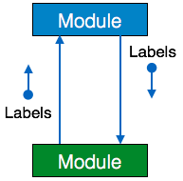
3. Control Flow
It represents the flow of control between the modules. It is represented by directed arrow with filled circle at the end.
Dept of CSE

Slide 94
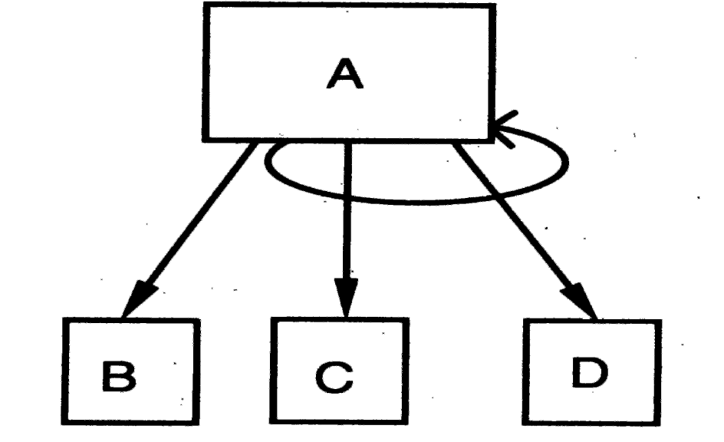
4. Loop
A curved arrow represents the loop in the module. All the sub modules covered by the loop repeat the execution of the module.
let us consider a situation where module A has subordinates B, C, and D, and A repeatedly calls the modules C and D. This can be represented by a looping arrow around the arrows joining the subordinates C and D to A, as shown in Figure
Dept of CSE

Slide 95
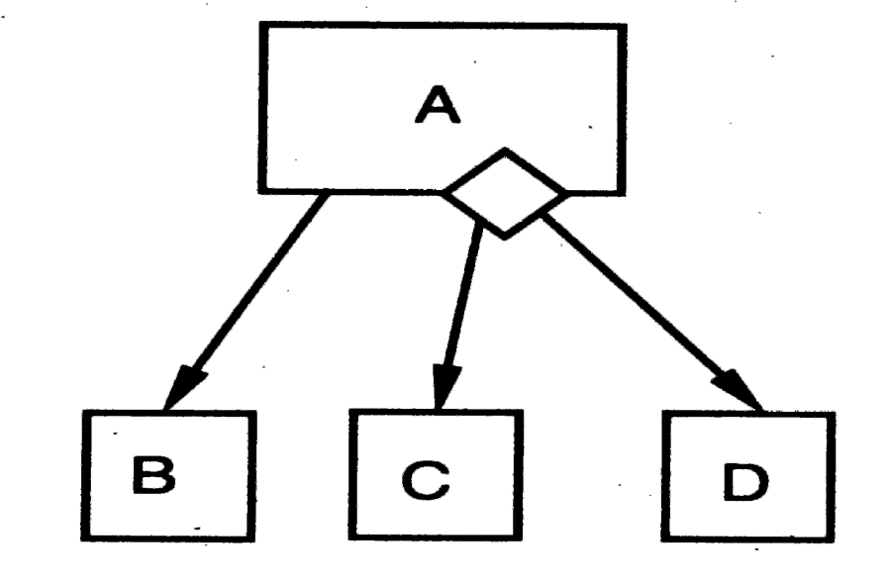
5. Conditional
It represents that control module can select any of the sub module on the basis of some condition. It is represented by diamond at the base of the module.
Major decisions can be represented similarly. For example, if the invocationvof modules C and D in module A depends on the outcome of some decision, that is represented by a small diamond in the box for A, with the arrows joining C and D coming out of this diamond, as shown in Figure
Dept of CSE

Slide 96
Example
As an example, consider the structure of the following program, whose structure is shown below
main () { int sum , n, N, a[MAX ]; readnums (a, &N); sort (a, N); scanf (&n); sum = add_n (a, n); printf ( sum ); } readnums (a, N) int a[], *N; { : } | sort (a, N) int a[], N; { : if (a[i] > a[t]) switch (a[i], a[t ]); : } /* Add the first n numbers of a */ add_n (a, n) int a[], n; { : }
Dept of CSE

Slide 97
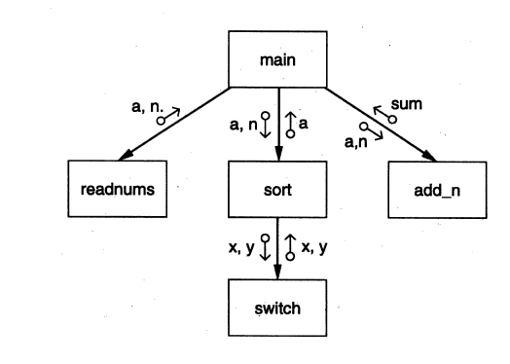
Dept of CSE

Slide 98
Structured Design Methodology:
The basic principle behind the structured design methodology is problem partitioning.
Structured design methodology partitions the system various subsystems, one for managing each major input, one for managing each major output, and one for each major transformation.
The overall strategy is to dealing with data and getting it in proper form for performing the transformation and producing the output in the desired form that requires considerable processing.
There are four major steps in the methodology:
1. Restate the problem as a data flow diagram
2. Identify the input and output data elements
3. First-level factoring
4. Factoring of input, output, and transform branches
Dept of CSE

Slide 99
We will now discuss each of these steps in more detail.
Restate the Problem as a Data Flow Diagram
  To use this methodology, the first step is to construct the data flow diagram for the problem.
  Data flow diagrams are drawn in both requirements phase and design phase.
  In the requirements analysis, a DFD is drawn to model the problem domain. The analyst has little control over the problem, and hence his task is to extract from the problem all the information and then represent it as a DFD.
  During design phase , a DFD is drawn to model the solution domain That is, the DFD during design represents how the data will flow in the system when it is built.
Dept of CSE

Slide 100
How to draw a DFD diagram:
Start with identifying the inputs and outputs
Work your way from inputs to outputs, or vice versa
  If stuck, reverse direction
  Ask: "What transformations will convert the inputs to outputs"
Never try to show control logic.
  If thinking about loops, if-then-else, start again
Label each arrow carefully
Make use of * and +, and show sufficient detail
Ignore minor functions in the start
For complex systems, make dfg hierarchical
Never settle for the 1st dfg
Dept of CSE

Slide 101
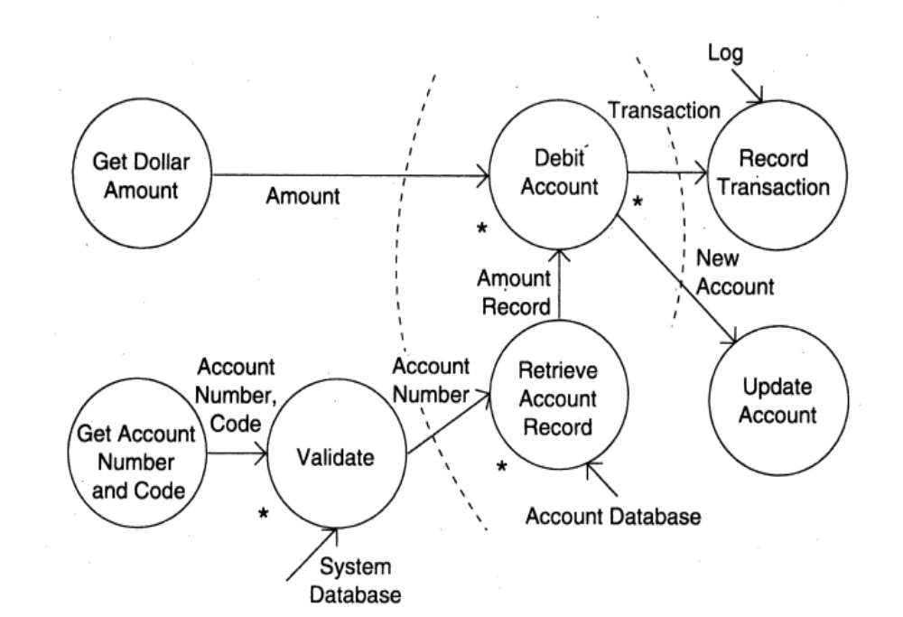
Example: A DFD of an ATM is shown in the below Figure
Dept of CSE

Slide 102
There are two major streams of input data in this diagram. The first is the account number and the code and the second is the amount to be debited.
The transform debit account has two outputs, one used for recording the transaction and the other to update the account.
Dept of CSE

Slide 103
2. Identify the Most Abstract Input and Output Data Elements.
The goal of the second step is to separate the transforms in the data flow diagram that convert the input or data to the desired format from the ones that perform the actual transformations.
For this separation , once the data flow diagram is ready the next step is to identify the highest abstract level of the input and output.
The most abstract input data elements are those data elements in the data flow diagram that are farthest removed from the physical inputs but can still be considered inputs to the system.
The most abstract input data elements often have little resemblance to the actual physical data. These are often the data elements obtained after operations like error checking, data validation, proper formatting, and conversion are complete.
Dept of CSE

Slide 104
Most abstract input data elements are recognized by starting from the physical inputs and traveling toward the outputs in the data flow diagram, until the data elements are reached that can no longer be considered incoming.
Similarly, we identify the most abstract output data elements by starting from the outputs in the data flow diagram and traveling toward the inputs.
These are the data elements that are the most removed from the actual outputs but can still be considered outgoing.
Central transforms perform the basic transformation for the system , taking the most abstract input and transforming it into most abstract output.
The purpose of having central transforms deal with the most abstract data items is that the modules implementing these transforms can concentrate on performing the transformation without being concerned with converting the data into proper format, validating the data, and so forth.
Dept of CSE

Slide 105
Consider now the data flow diagram of the automated teller shown in the above Figure.
The two most abstract inputs are the dollar amount and the validated account number.
The validated account number is the most abstract input,
rather than the account number read in, as it is still the input—but with a guarantee that the account number is valid. The two abstract outputs are obvious. The abstract inputs and outputs are marked in the data flow diagram.
Dept of CSE

Slide 106
3. First-Level Factoring:
Having identified the central transforms and the most abstract input and output data items, we are ready to identify some modules for the system.
We first specify a main module, whose purpose is to invoke the subordinates.
The main module is the overall control module, which will form the main program in the implementation of the design.
It is the coordinate module that invokes the input modules to get the most abstract data items, passes these to the appropriate transfer modules and delivers the results of the transform modules to other transform modules until the most abstract data items are obtained . These are the passed to the output modules.
Dept of CSE

Slide 107
Let us examine the data flow diagram of the ATM. We have already seen that this has two most abstract inputs, two most abstract outputs, and two central transforms. Drawing a module for each of these, we get the structure chart shown in below Figure
Dept of CSE

Slide 108
4. Factoring the Input, Output, and Transform Branches
Dept of CSE

Slide 109
Object-Oriented Design:
Object-oriented design (OOD) is the process of creating a software system or application utilizing an object-oriented paradigm.
This technique permits the creation of a software solution based on object notion. OOD is an implementation of the object-oriented programming (OOP) paradigm.
The main aim of Object Oriented Design (OOD) is to improve the quality and productivity of system analysis and design by making it more usable.
There are many advantages that OO systems offer.
  An OO model closely represents the problem domain, which makes it easier to produce and understand designs.
  As requirements change, the objects in a system are less immune to these changes, thereby permitting changes more easily.
  Inheritance and close association of objects in design to problem domain entities encourage more re-use, i.e., new applications can use existing modules more effectively, thereby reducing development cost and cycle time.
Dept of CSE

Slide 110
OO Concepts:
Objects: Objects are all the entities involved in the solution design. Persons, banks, companies, and users are all examples of objects. Every object has some properties associated with it, along with some methods for performing operations on those attributes.
Class: Classes are generic descriptions of objects. An object is a class instance. A class defines all the properties an object can have and the methods that represent the object's functionality.
Messages: Objects communicate by passing messages. Messages contain the target object's integrity, the name of the requested operation, and any other action required to complete the function. Messages are frequently implemented through procedure or function calls.
Dept of CSE

Slide 111
Abstraction: Abstraction is used in object-oriented design to deal with complexity. Abstraction is the removal of the unnecessary and the amplification of the necessary.
Encapsulation: It is also known as information concealing. The processes and data are tied to a single unit. Encapsulation not only groups together an object's vital information but also restricts access to the data and operations from the outside world.
Inheritance: OOD allows similar classes to be stacked hierarchically, with lower or sub-classes being able to import, implement, and reuse variables and functions from their immediate superclasses. This OOD characteristic is known as inheritance. This facilitates the definition of specialised classes as well as the creation of generic classes.
Polymorphism: OOD languages give a technique for assigning the same name to methods that perform similar functions but differ in arguments. This is referred to as polymorphism, and it allows a single interface to perform functions for multiple types. The relevant piece of the code is run depending on how the service is invoked.
Dept of CSE

Slide 112
Unified Modeling Language (UML) Diagrams:
Refer the material given in class
Dept of CSE

Slide 113
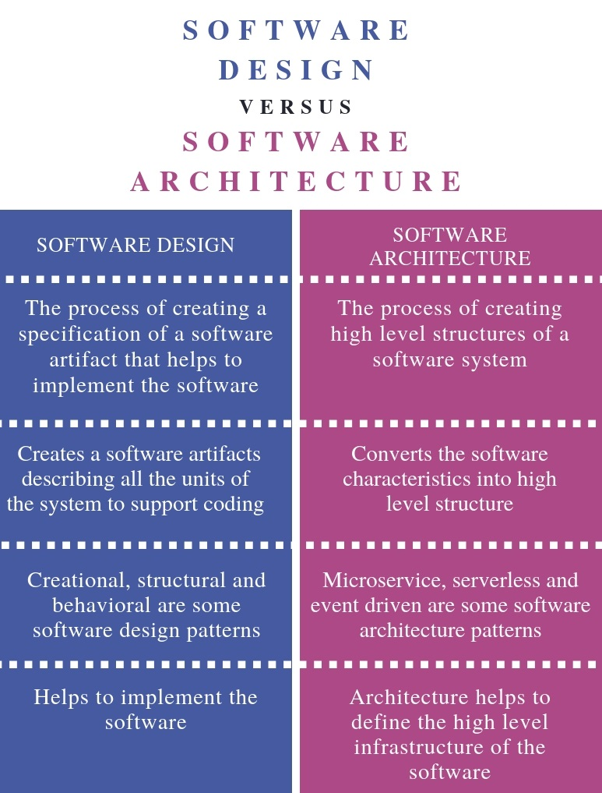
Dept of CSE

